Slide 2
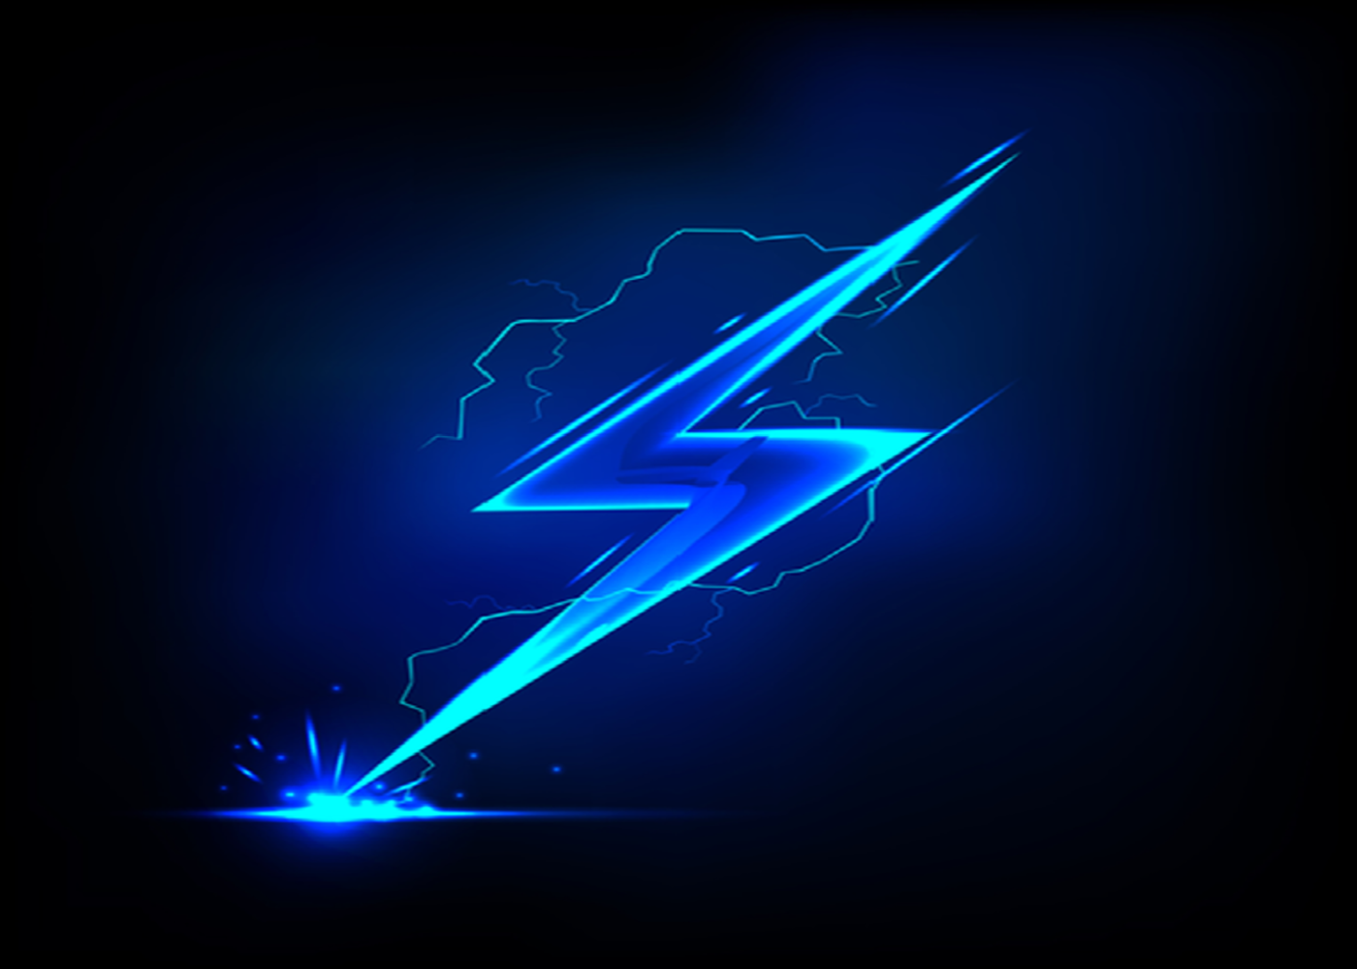


EV App
From Gas To No Gas, an app to help
switch over to electric vehicles
VS
Ron Gerschel
Victor Lora
Joshua Rosenzweig
Adrian Pichardo
Notes:
Introduction

Slide 3
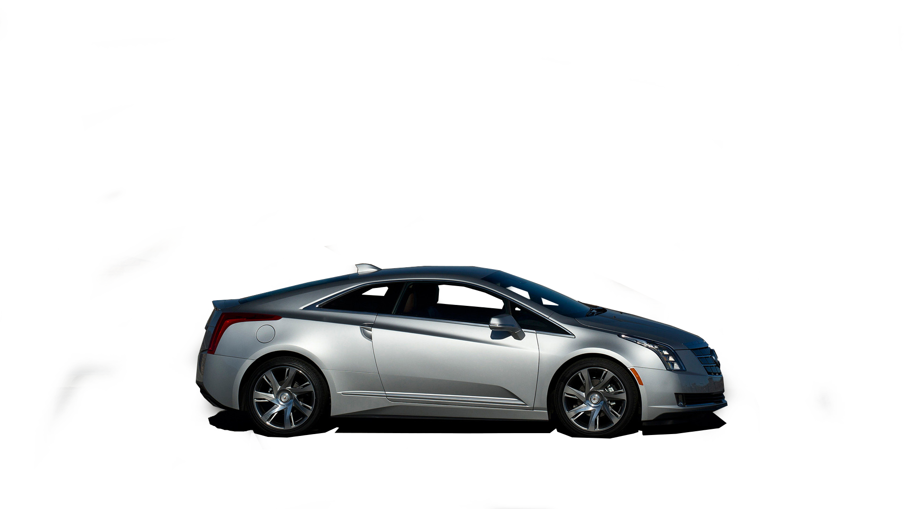
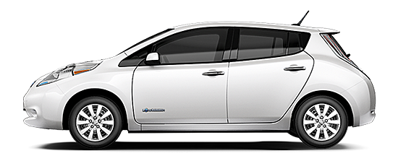
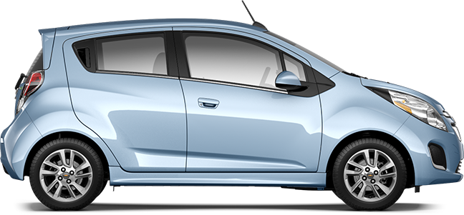
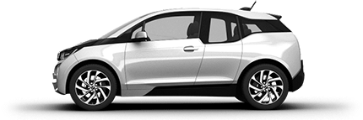
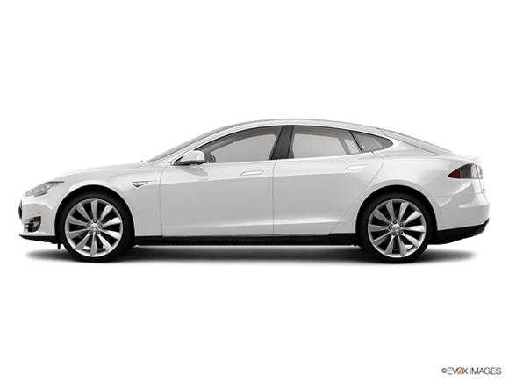
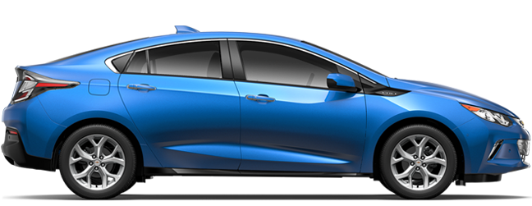
List Some Electric Vehicles
Cadillac ELR
Nissan Leaf
Chevrolet Spark EV
BMW I3
Chevrolet Volt
Tesla Model S
Notes:
J

Slide 4
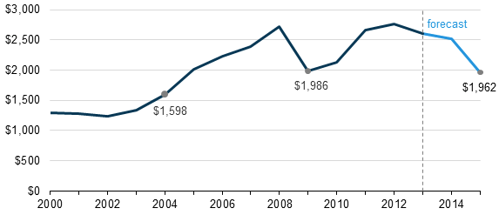
Problems
Money • Familiarity • Environment
Average annual household expenditures on gasoline and motor oil (2000- 2015)
Notes:
J: In 2014, the U.S. alone used about 140 billion gallons of gasoline.
Only 740,000 electric vehicles have been sold around the world and currently in the U.S. alone there are only 345,000 electric vehicles on the road.
Dealerships don't often like electric vehicle due to the fact that it takes more effort to sell them due to the customers lack of familiarity.
Per 100-mile trip: Conventional emit 99lb CO2; Hybrids emit 51lb; EV emit 54lb CO2
“Consider the lack of familiarity. In a survey by researchers from Indiana University and the University of Kansas, respondents couldn't correctly answer basic factual questions about plug-in electric vehicles more than 60% of the time. Some 75% of wrong answers underestimated the beneficial aspects of the vehicles.”

Slide 5
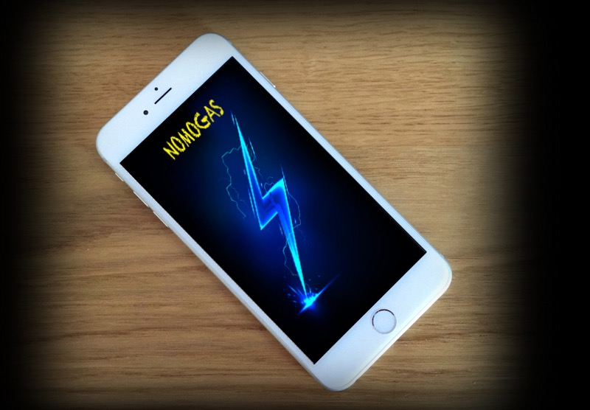
Solution
Notes:
Josh: Ev App:
- Teaches
- Promotes
- Compares

Slide 6




Technology
Notes:
V:
Opted for an iOS application
Compatible with all iPhones, iPads, iPod Touch and soon the Apple Watch
Our application takes advantage of all the technologies available on iOS devices, which include: GPS, geofencing, and BlueTooth

Slide 7
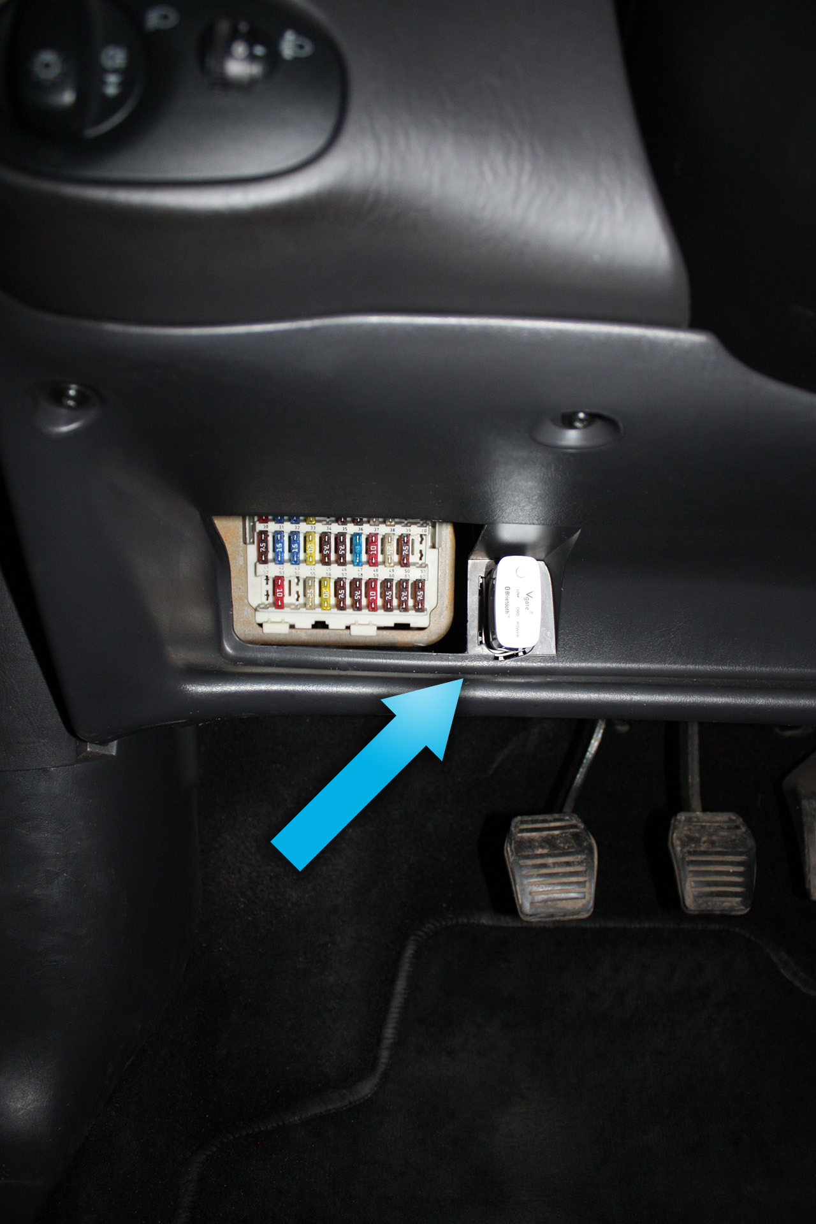
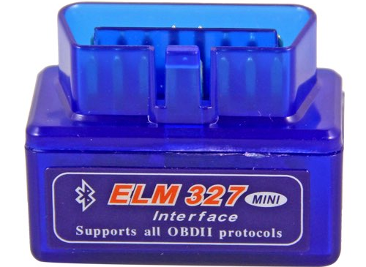
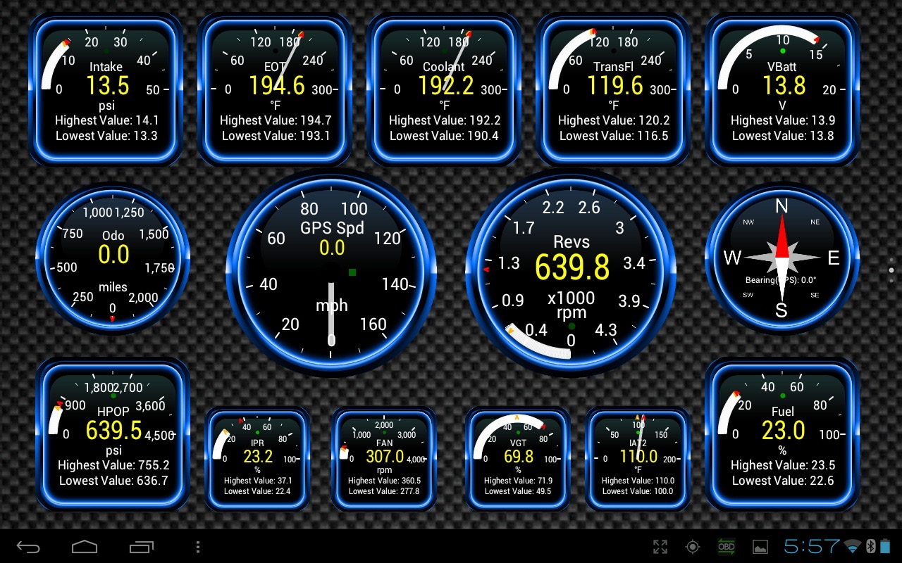
Notes:
OBD2 is a device that connects to your vehicles onboard computer and reads:
MPH
Revolutions/s
Fuel Levels
(when available) GPS
Temperatures
Engine Codes
We will use bluetooth communication to gather the vehicles information and feed it to our application, allowing us to have more ACCURATE data

Slide 8



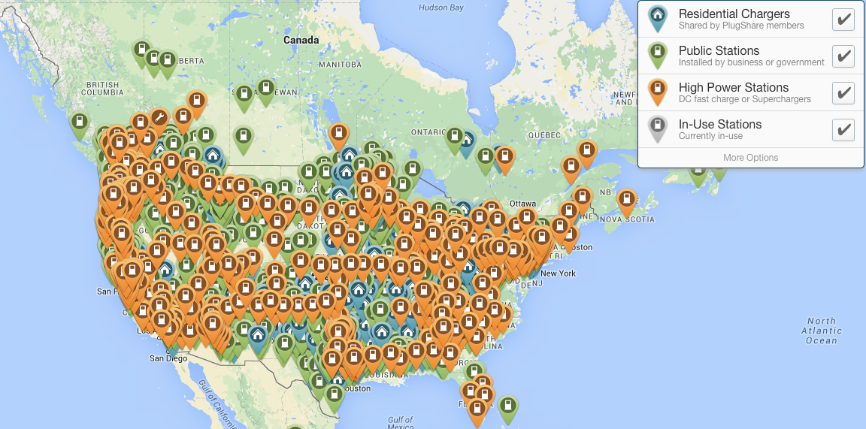
Competition
Azra Network
Notes:
V: These are our competitors:
Their main feature is nearby charging stations for Electric Vehicles ONLY
PlugShare: PlugScore (Charging station reviews), Notifications for new charging stations
GreenCharge: Automatic Syncing (ONLY with: Nissan Leaf, Prius Plug-in, or Ford Focus EV), Sharing charge history, Historical Data
Azra Network: Like the others, find nearby charging stations, but also Integrated payment

Slide 9
Feature | EVApp | Green Charge | PlugShare | Azra Network
Set up charge reminder notifications | X | X |  | X
Calculate energy costs | X | X
Geo-localize available charging stations | X | X | X | X
Station Reviews | X |  | X
Follow a charging sessions progress |  |  |  | X
Customize app to any vehicle | X
Vehicle diagnostics | X
Vehicle information | X
Track range, speed and distance traveled | X
Integrated payments |  |  |  | X
Notes:
V:
Competitors DON’T:
Allow the user to communicate with the vehicles onboard computer
Track ranges, mph, distance traveled
Support all vehicles (we support both gas and electric)
Offer useful features for both gas and electric vehicle users (which make our app appealing to a wide audience)
Our App Offers:
Nearby charging stations and gas stations
Finds nearby mechanics and dealers
It can perform a car check using the bluetooth to tell you if there are any issues with the car and it can tell you which mechanic to go to fix the issues.
That feature also offers the hours and estimated cost of fixing your vehicle.
It will also take your charge and gas amount into consideration to optimize suggestions
In addition there is also a navigation function built right into the app
The navigation function takes into account how much charge you have and how much gas is remaining and can tell you how far you can still drive.
The app also gives you general information about your vehicle
And there is also a built in browser to purchase accessories for your car

Slide 10
Business Model
FREE
Premium $4.99
Advertisements
Charging Stations, Gas Stations, Dealers and Mechanics promote themselves
Feature | Free | Premium
Car Info | X | X
GeoCharge |  | X
Accessories | X | X
Low Mileage Alerts |  | X
Maps | X | X
Car Check |  | X
Notes:
R:
The fun facts are spread throughout the app, 1/10 will be an advertisement
There will be a premium app ($4.99)
Dealers, mechanics, gas stations and charging stations pay a small fee, then when the user needs any of the listed utilities the app will populate a map based on the dealers, mechanics and stations that have paid to be on the list (they will have added features such as prices, offers and in the case of mechanics what they can fix)
Car Info - gives you the info of the car (MPG, Engine, Auto/Man, etc..)
GeoCharge - this helps you find what you need, charging station? gas station? mechanic? This map will be populated with sponsored places so that you can find the right place for you
Accessories - inApp purchases for parts and accessories (autoZone)
Low Mileage Alerts - when your car is slow on gas/electricity the App will give you a warning and calculate how much further you can go, based on that it will tell you which charging station is best for you (calculated by price and distance)
Maps - Apple Maps integrated into the app
Car Check - Car Broken? No problem EV App will tell you what’s wrong and where to fix it!

Slide 11
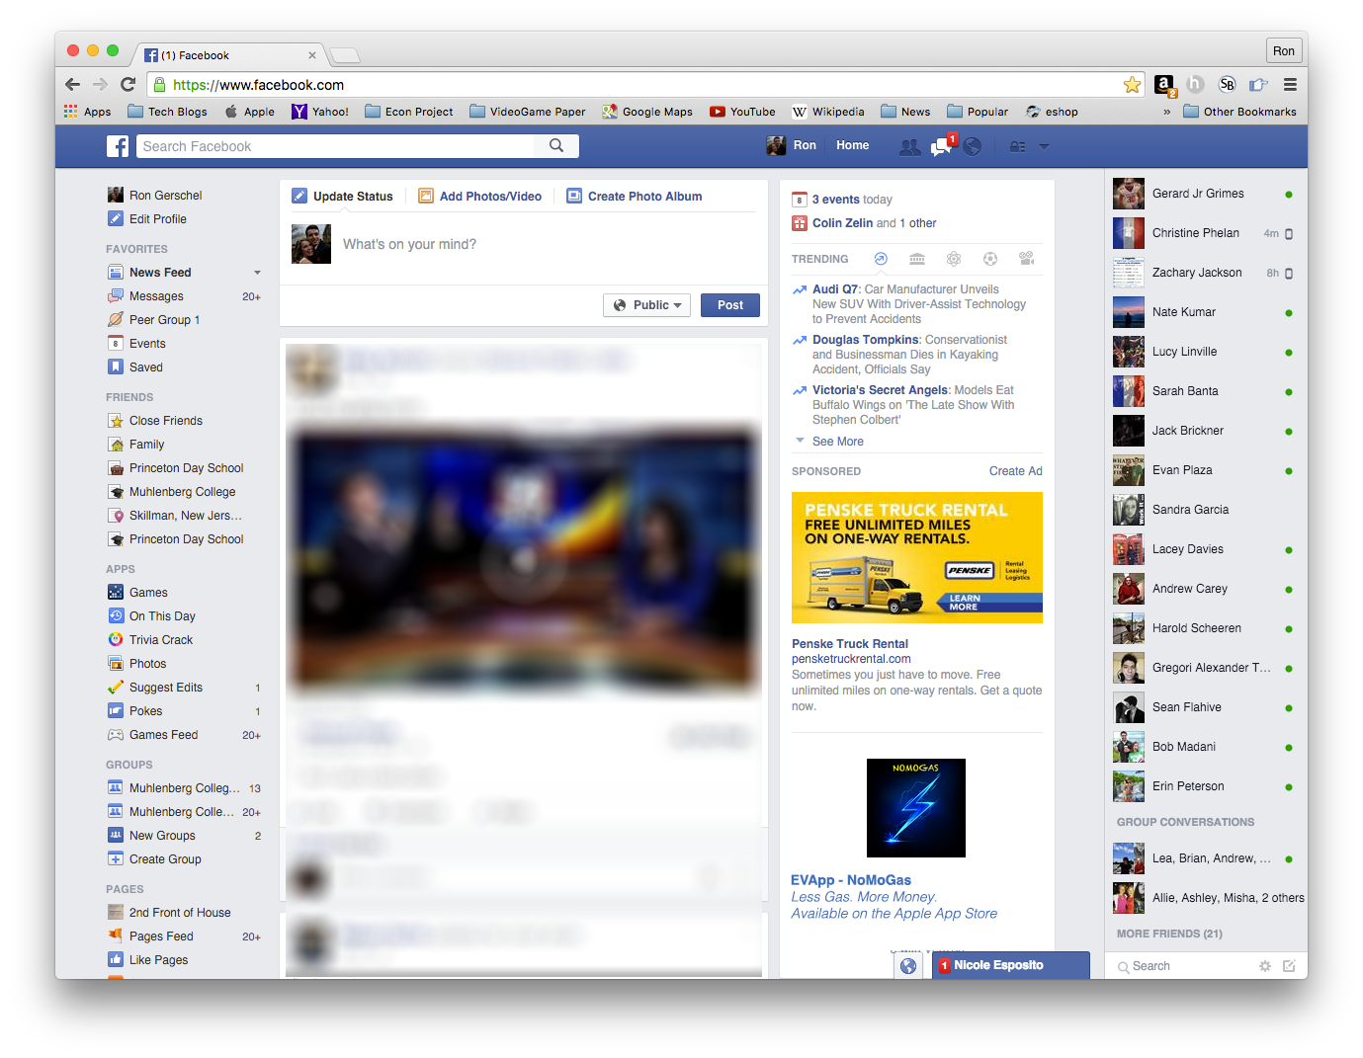
Marketing & Sales
Notes:
R: We will use various different Social Media advertisement options. When someone searches in their web browser for any terms such as “electric” “car” “new car” etc… they will begin seeing ads for our app on their social media sites
The app will begin growing slowly and then pick up in popularity and hopefully grow exponentially from that point on as it gains popularity.

Slide 12
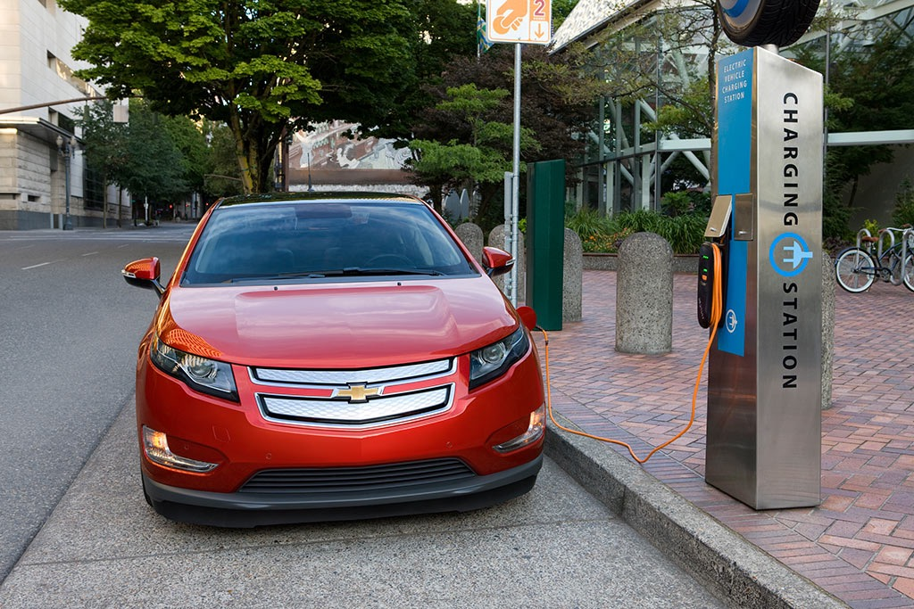
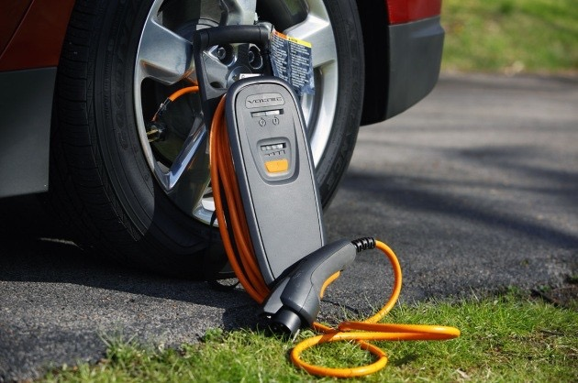
Projections
All dealers will eventually be added.
Our company will break even and gain profitability.
40,000 downloads from the app store each year.
Average revenue is $4000 a year.
Notes:
R

Slide 13
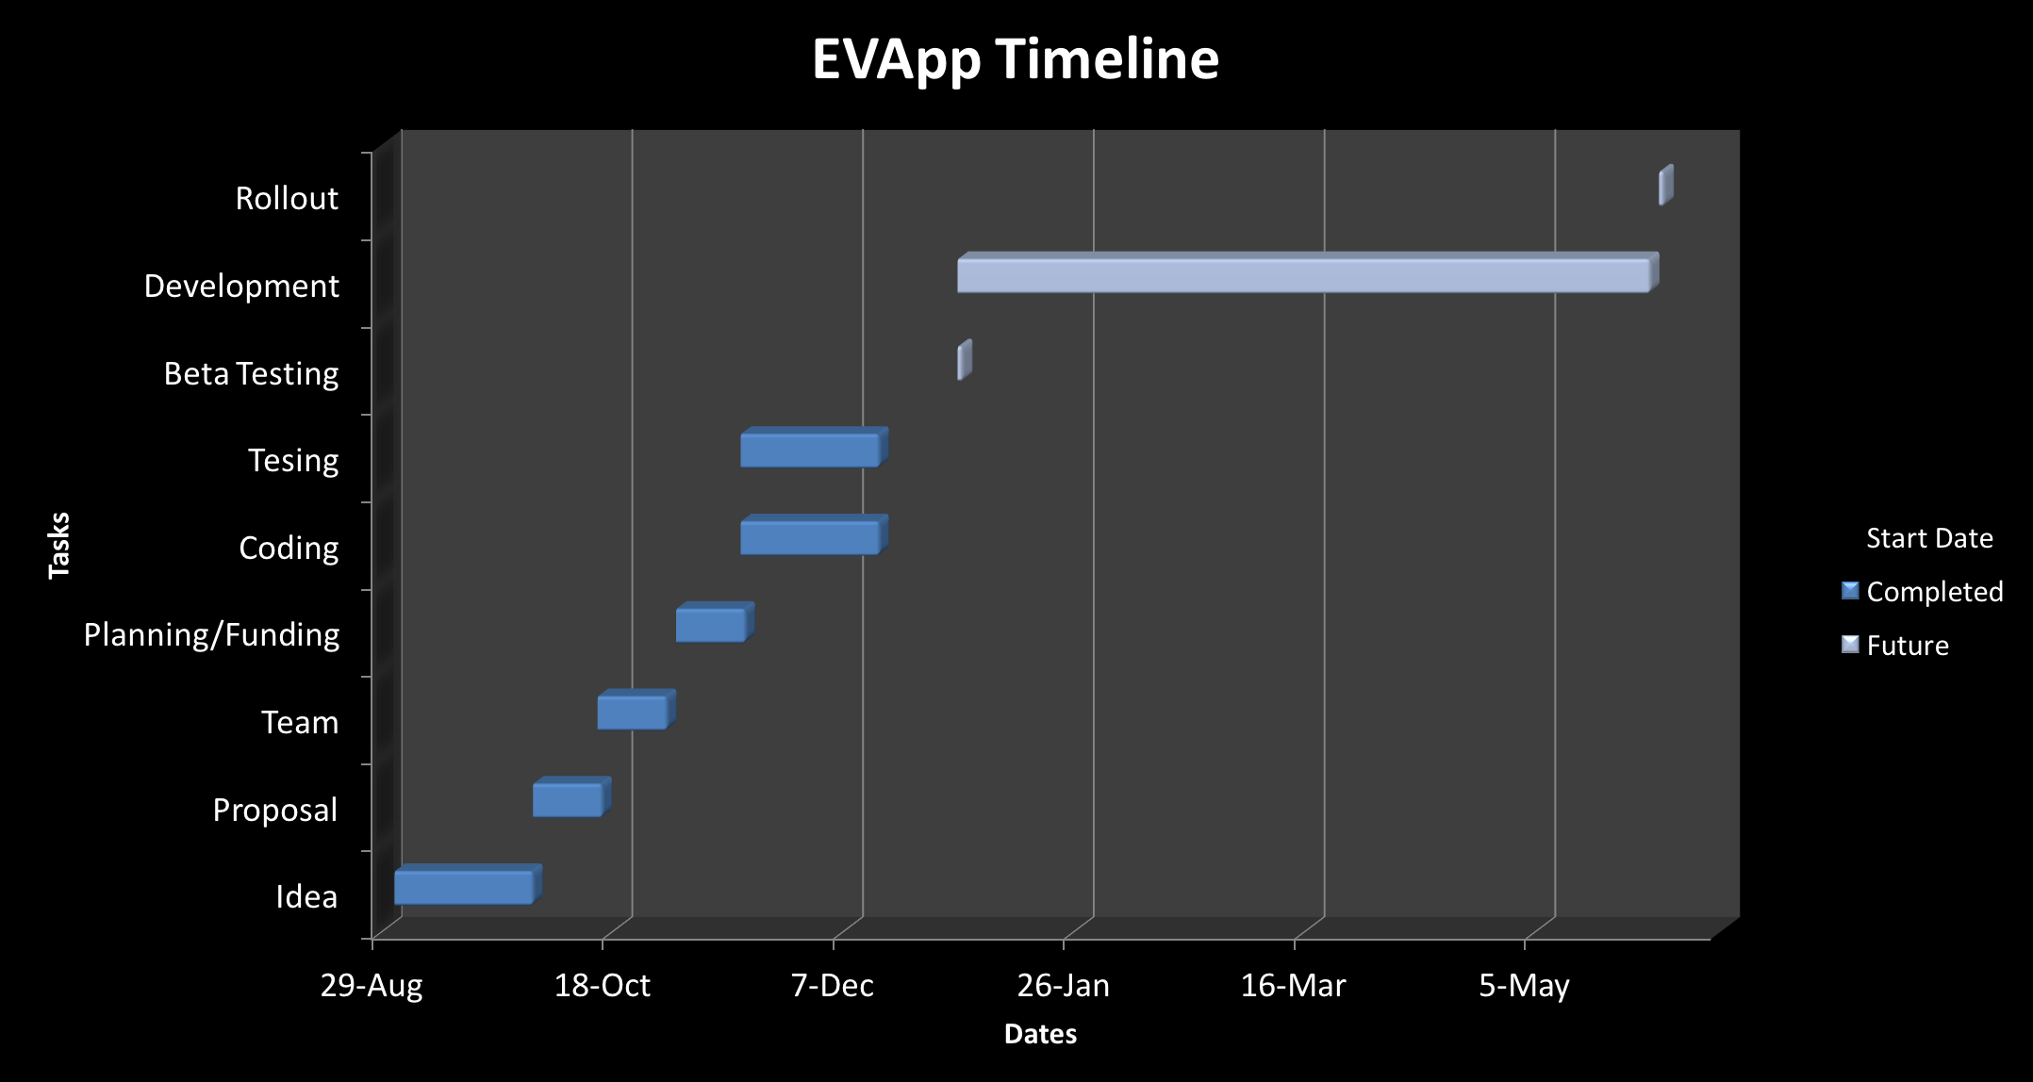

Status & Timeline
Currently: Testing
Notes:
A: August - idea was generated
October - original proposal
Late October - team was assembled
Early November - planning and funding
December - Coding and Testing
End of December - Beta Testing
January to June - Further development based on feedback from beta users
June - Roll out the application

Slide 14
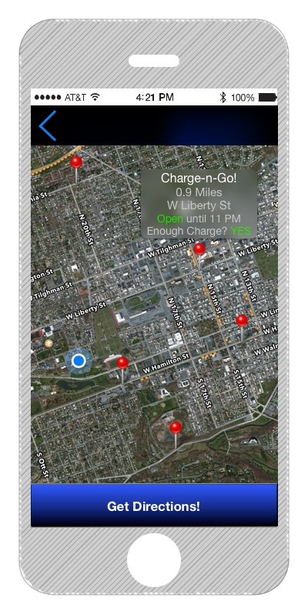
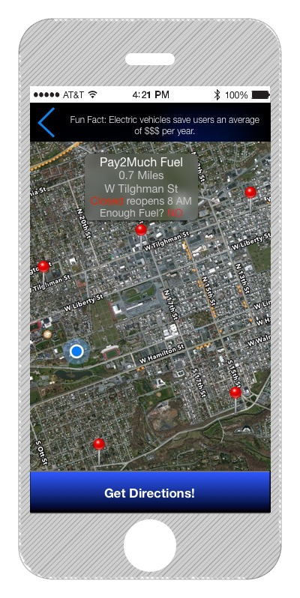
App Future
Notes:
Adrian

Slide 15
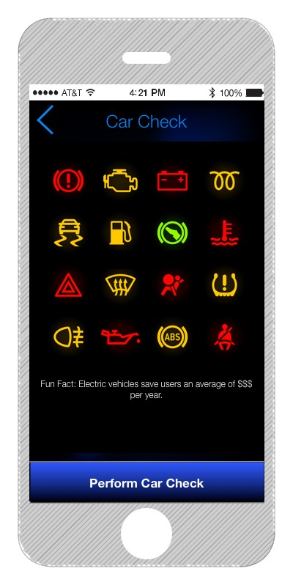
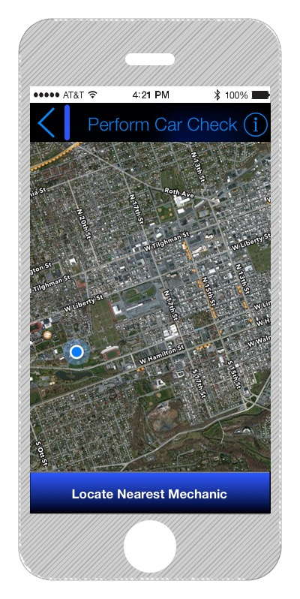
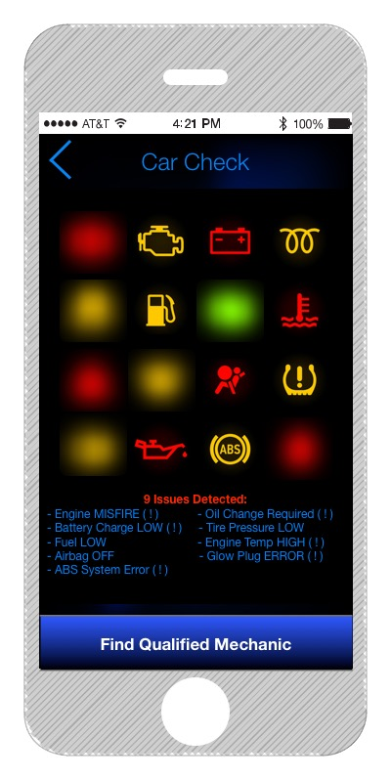

Slide 16
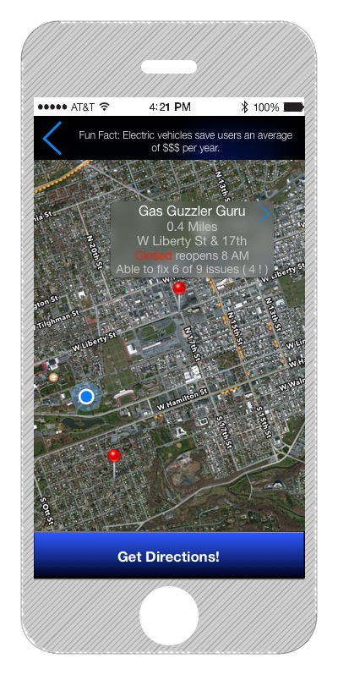
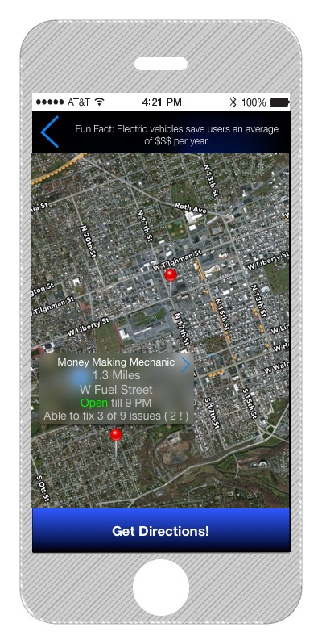

Slide 17
Summary
EV App is FREE
($4.99 for Premium)
—
Saves users money
—
Teaches users about Electric Vehicles
—
Helps the environment
—
Open market
—

Slide 18
Sources
Intro Page Image: http://www.theenergycollective.com/sites/theenergycollective.com/files/imagepicker/488516/ev%20vs%20gas.jpg
NY Times - A Car Dealers Won’t Sell: It’s Electric: http://www.nytimes.com/2015/12/01/science/electric-car-auto-dealers.html?_r=0
Plug In Sales: https://images.angelpub.com/2015/15/30270/2.png
Iphone 6: http://mockuphone.com/static/images/phones/iphone6plus/iphone6plus_spacegrey_portrait.png
Iphone 6 and 6 Plus: http://www.talkmob.com/wp-content/uploads/2015/04/How-to-Clear-Call-History-Logs-on-iPhone-6.png
Apple Logo: https://upload.wikimedia.org/wikipedia/commons/thumb/f/fa/Apple_logo_black.svg/500px-Apple_logo_black.svg.png
Xcode: http://a4.mzstatic.com/us/r30/Purple69/v4/ef/93/47/ef9347bf-7e46-6b94-aad6-9b7354dbbaa2/icon256.png
Gas Station: http://stapletonion.com/wp-content/uploads/2014/07/gas-pumps-at-pocket-parks.jpg
Charging Station: http://www.clippercreek.com/images/image2_position3.png
iOS: http://img2.wikia.nocookie.net/__cb20121220233830/logopedia/images/6/6c/IOS.png
PlugShare Map: http://www.plugshare.com
PlugShare Logo: http://www.plugshare.com/drivesolar/assets/img/logo-plugshare.png
GreenCharge Logo: http://www.greencharge.net/wp-content/uploads/2014/10/GCN_logo.png
Azra Network Logo: https://lh3.ggpht.com/X5JN16gwwM4aYJu9K1ye7AY879axAjhBQT1bFmngO0Il65UWZci-68it8aZflm858kY=w300
Plugged In: http://media.mlive.com/kzgazette_impact/photo/k0416charge2jpg-198b153104ffa96f.jpg
Charging: http://cdn.ecomento.com/wp-content/uploads/2013/05/2013-Chevrolet-Volt-Review-Charging-Station.jpg
Volt Charge Cord: http://insideevs.com/wp-content/uploads/2013/07/volt-charger.jpg
Tesla Model S: http://auto-shipping-carrier.ca/uploads/TESLA/tesla-model-x-electric-_SUV.jpg
I3: https://cdn4.3dtuning.com/info/BMW%20i3%20series%202014%20sedan/carchooser/side.png
Leaf: http://rogeeauto.com/nissan/images/trims/a456a6cd7c8e62f5a6c11ca196c5d32e79579aa1.png
ELR: http://www.caricos.com/cars/c/cadillac/2014_cadillac_elr/1920x1080/73.html?
Spark EV: http://www.chevrolet.com/content/dam/Chevrolet/northamerica/usa/nscwebsite/en/Home/Vehicles/Cars/2016_Spark_EV/Overview/01_images/2016-chevrolet-spark-ev-baseball-card-648x301.png
Volt: http://www.chevrolet.com/content/dam/Chevrolet/northamerica/usa/nscwebsite/en/Home/Vehicles/Cars/2016_Volt/Model_Overview/01_images/2016-chevrolet-volt-ltz-baseball-card-648xvar-width.png

Slide 19


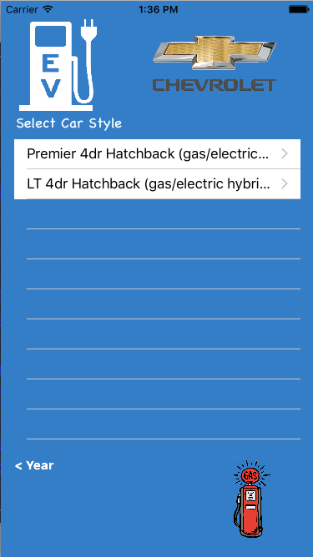
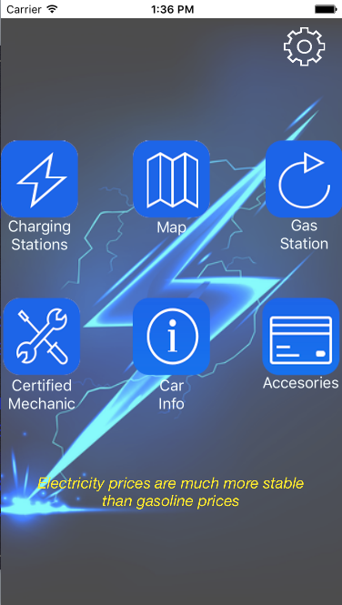
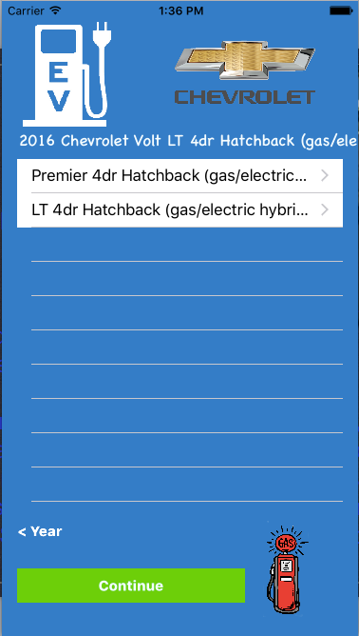
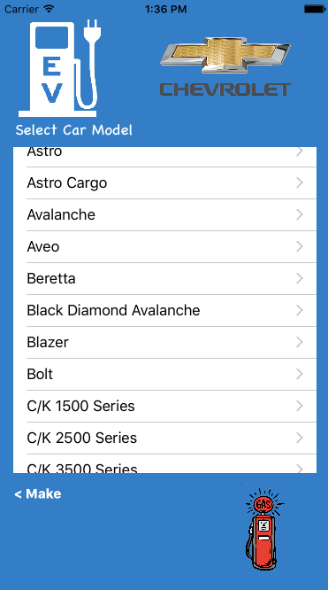
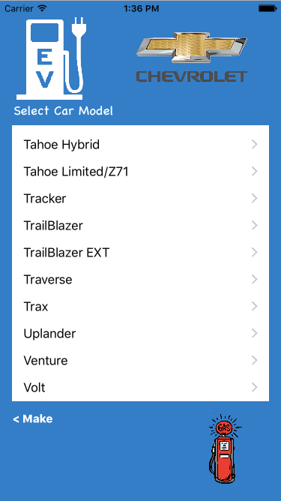
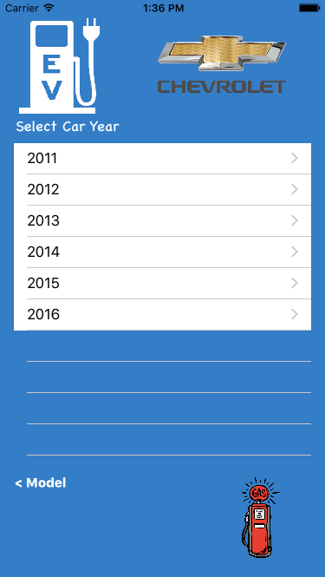
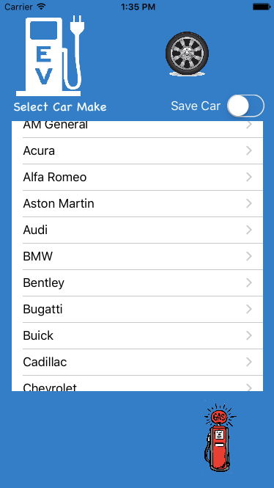
App Demo

